Slide 1


Slide 2

Our team
Stephan Danielov Stratev – Backend Developer
Alexander Zlatkov Yanev – Frontend Developer

Slide 3


The topic of our project
A website for a veterinary clinic

Slide 4

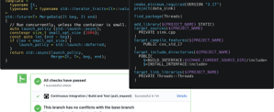
Contents
Website
Database
HighHealth

Slide 5

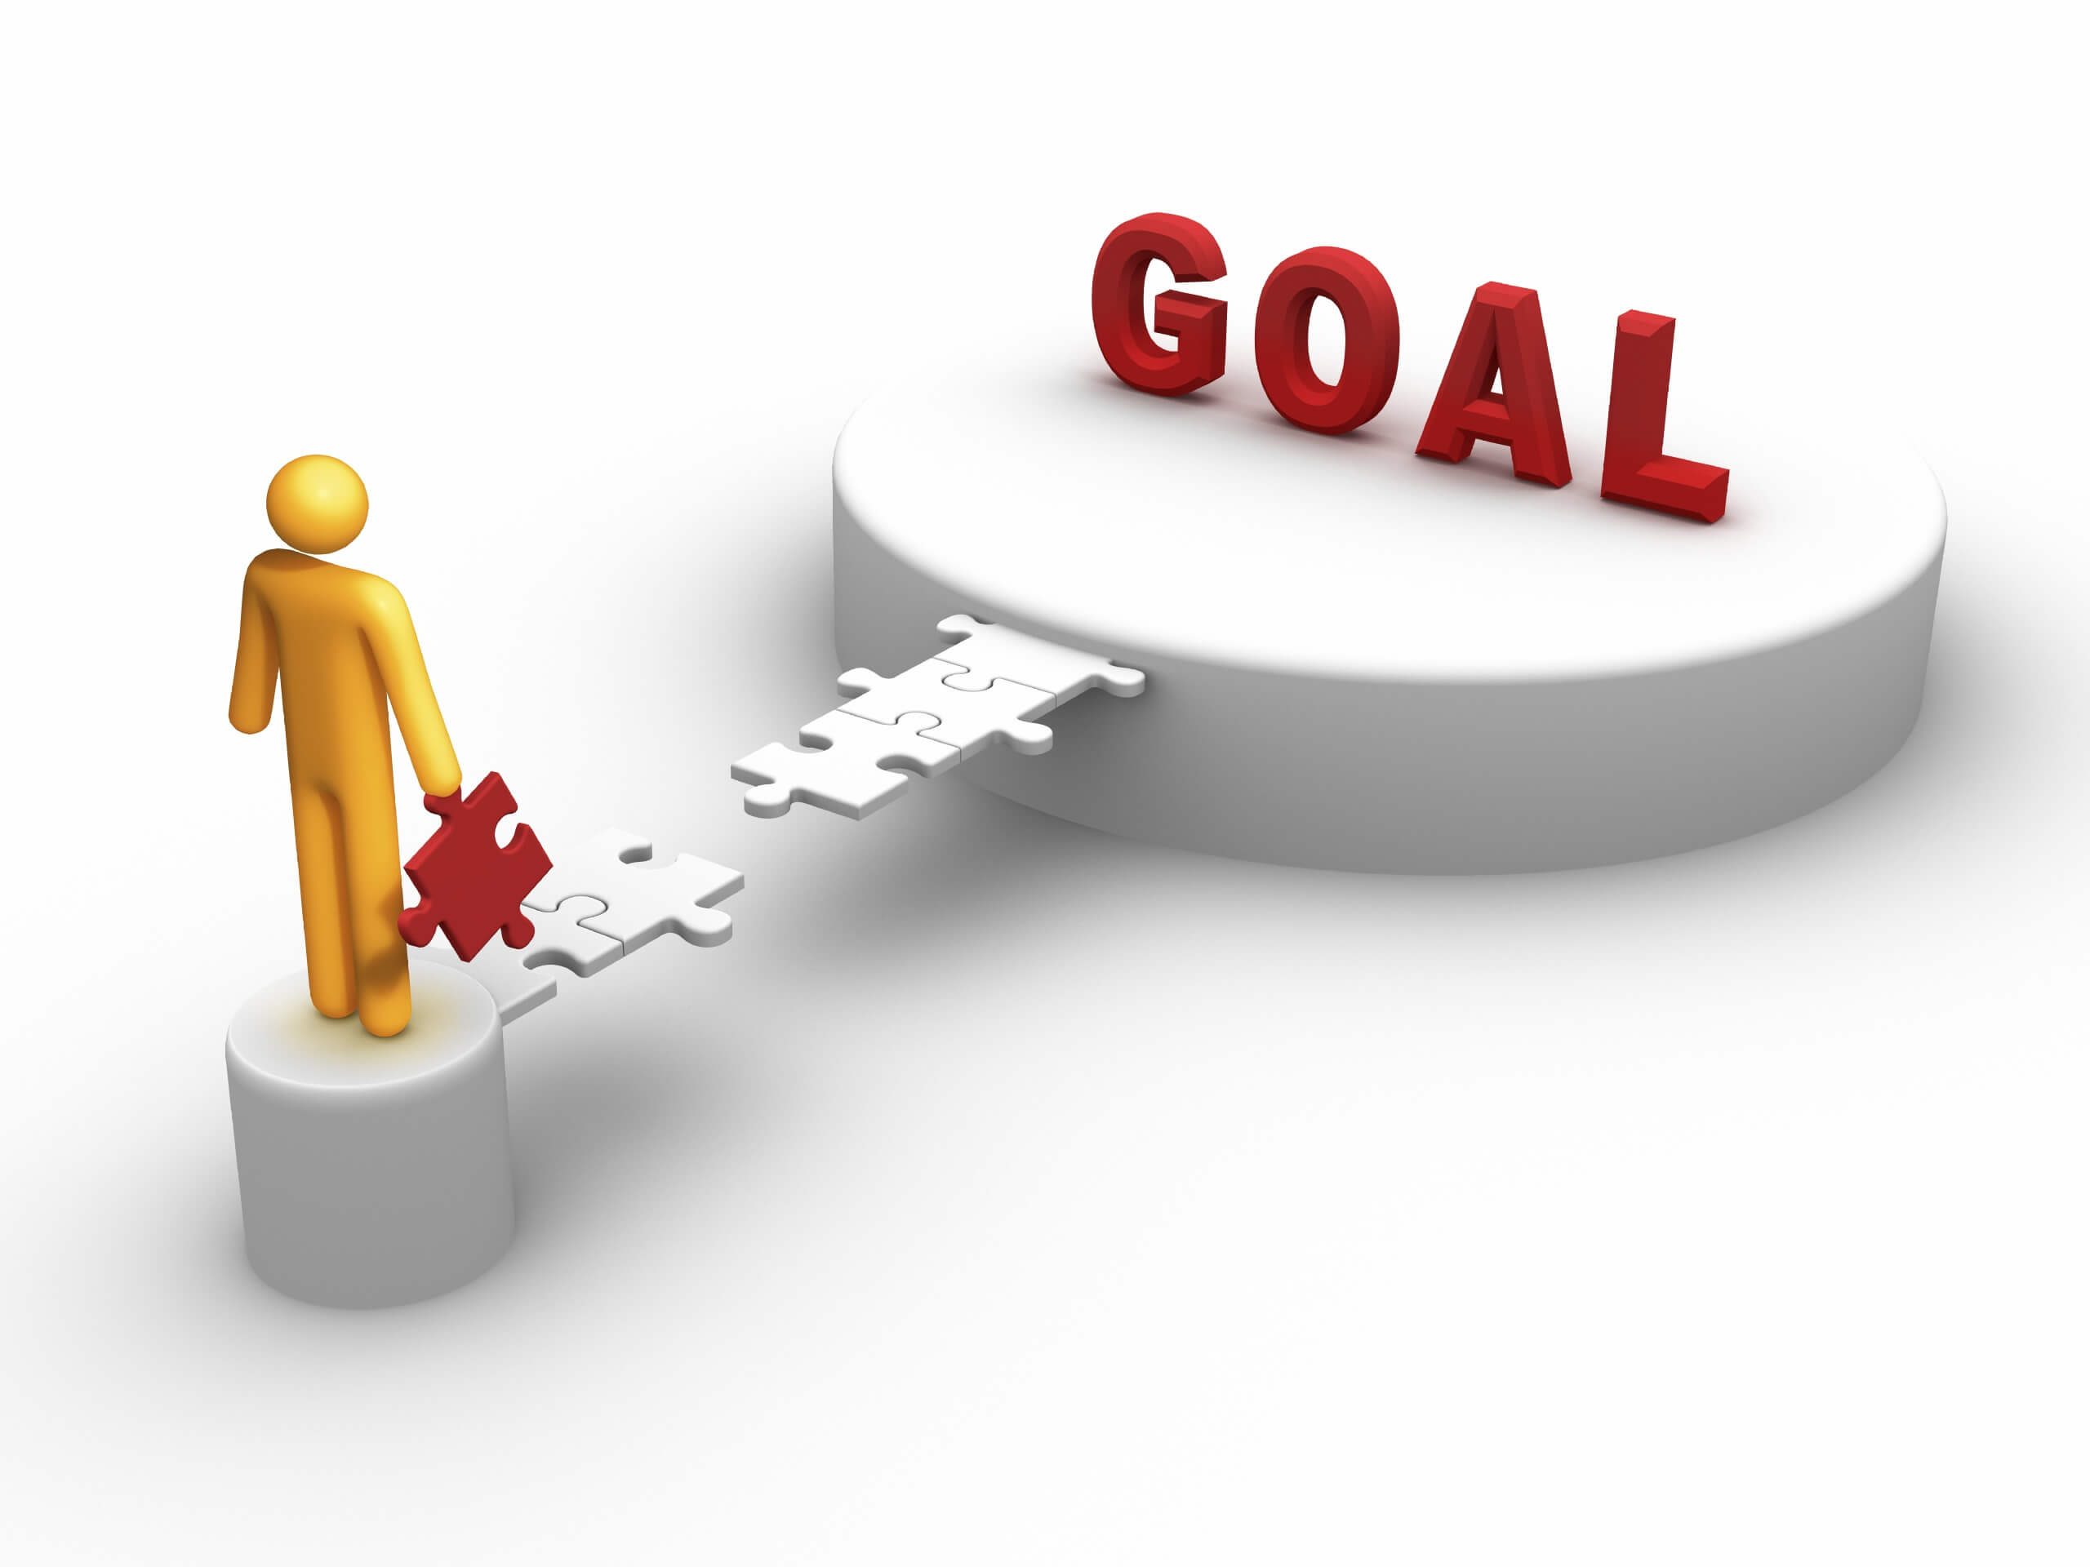
Goals
Create the concept of the project
Create the website
Create the database

Slide 6





Realization and used technologies

Slide 7

Showing the site
Showcasing the website

Slide 8


Conclusion

Slide 9
Thank you for the attention!
Made by HighHealth

